Slide 1
Angular Reactive Form
yangyanbin

Slide 2
ReactiveFormsModule
Import {ReactiveFormsModule} from ‘@angular/forms’
Exports the required infrastructure and directives for reactive forms, making them available for import by NgModules that import this module.
formGroup, formControl, formControlName, email, maxlength, required …

Slide 3
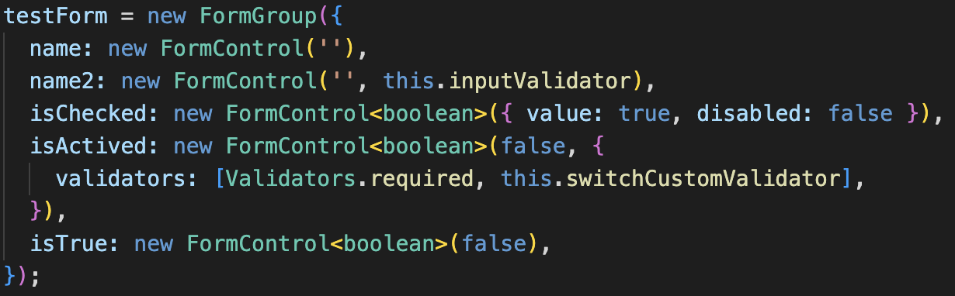
FormGroup,FormControl
import {FormGroup,FormControl} from ‘@angular/forms’

Slide 4


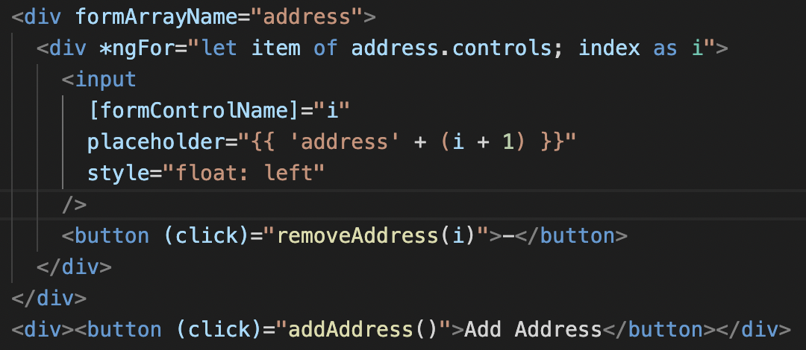
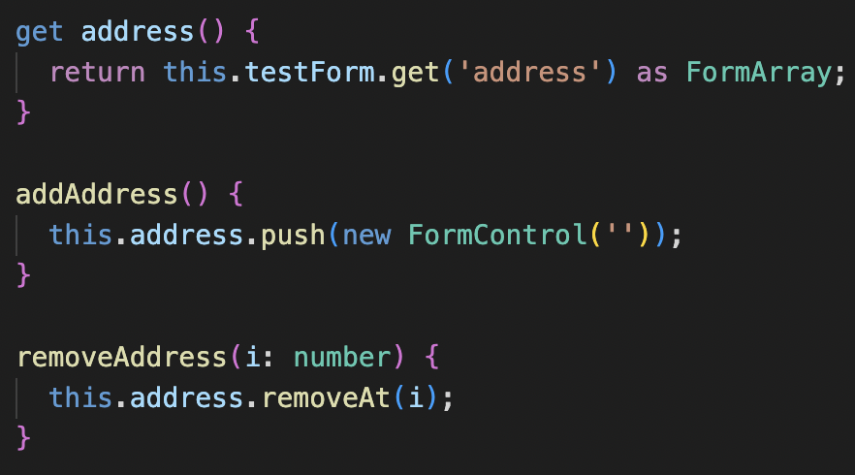
FormArray
new FormArray
formBuilder.array

Slide 5
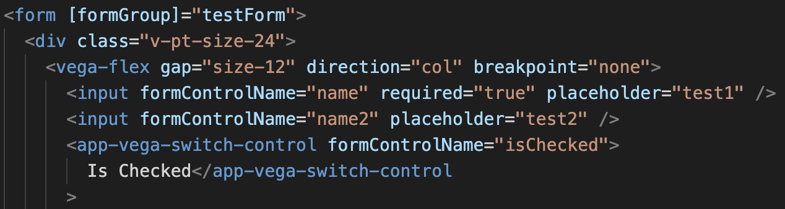
Directive formGroup,formControlName
<form [formGroup]=‘testForm’>
<input formControlName=‘name’>

Slide 6
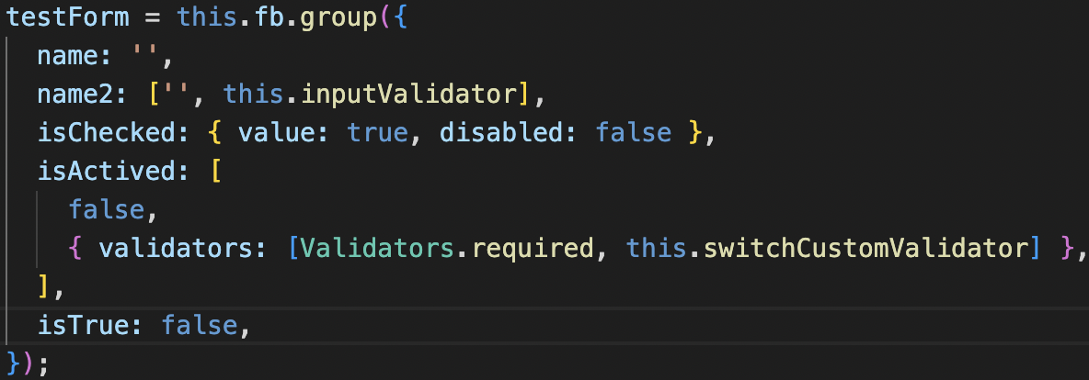
FormBuilder
import {FormBuilder} from ‘@angular/forms’
constructor(private fb:FormBuilder){}

Slide 7
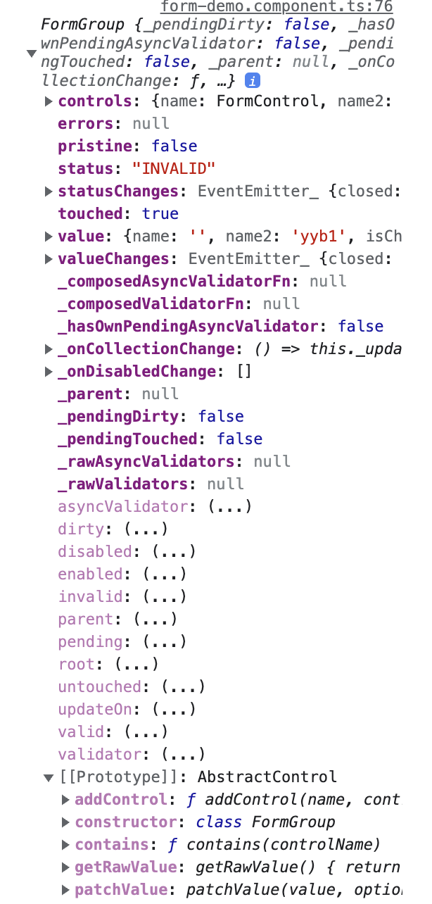
FormGroup Api
setValue(value), patchValue(value) : void
get(’controlName’) : control
getRawValue() : any
reset() : void
markAllAsTouched() :void
valid, invalid : boolean
touched, untouched: boolean
pending : boolean
valueChange : Observable
stateChange : Observable

Slide 8
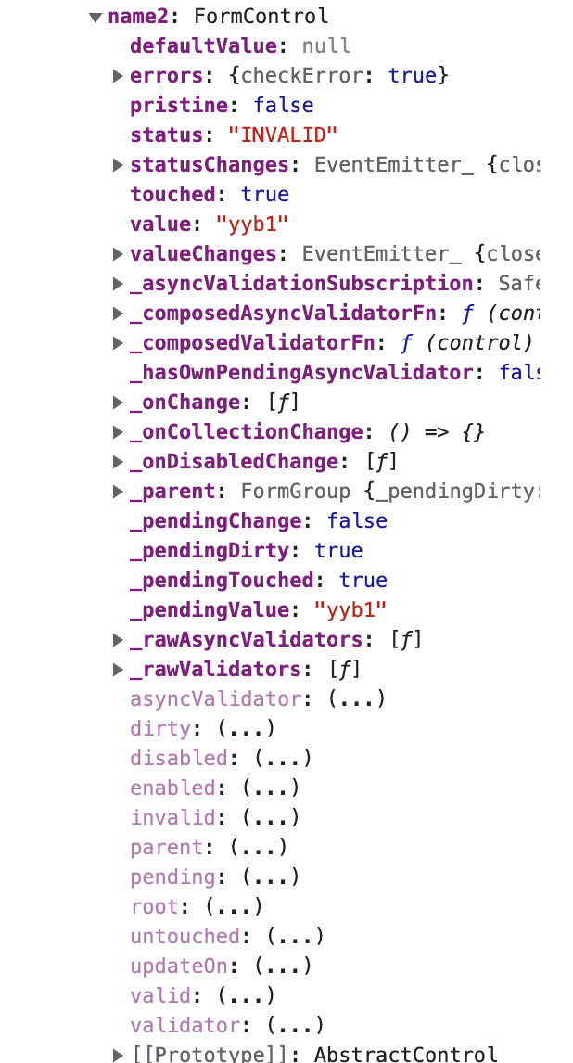
FormControl Api
hasError(’errorKey’) : boolean
disable() : void
enable() : void
value : any
valid, invalid : boolean
touched, untouched : boolean

Slide 9
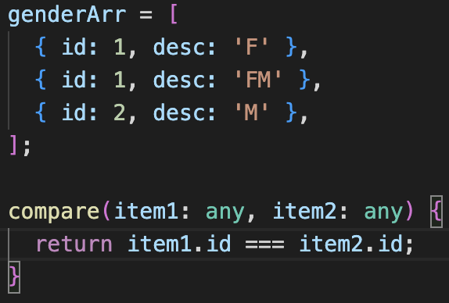
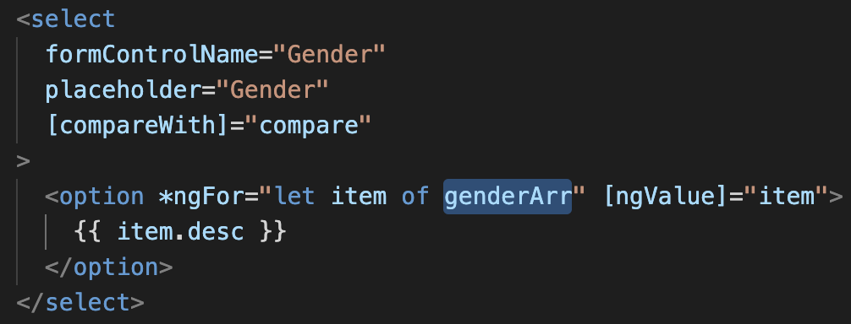
compareWith
compareWith : (option1,option2)=>boolean

Slide 10
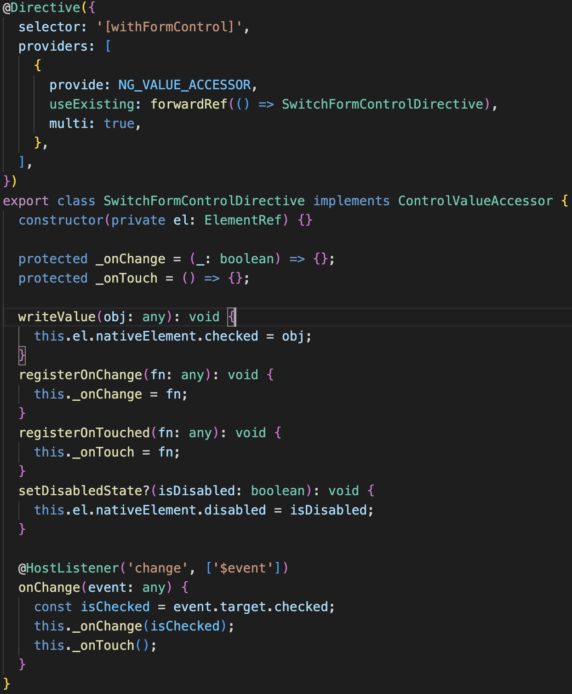
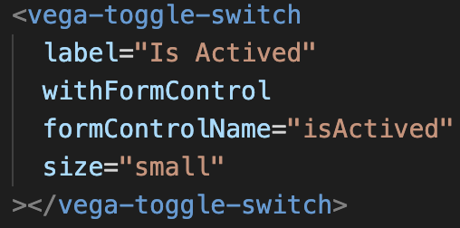
Custom FormControl element
directive

Slide 11
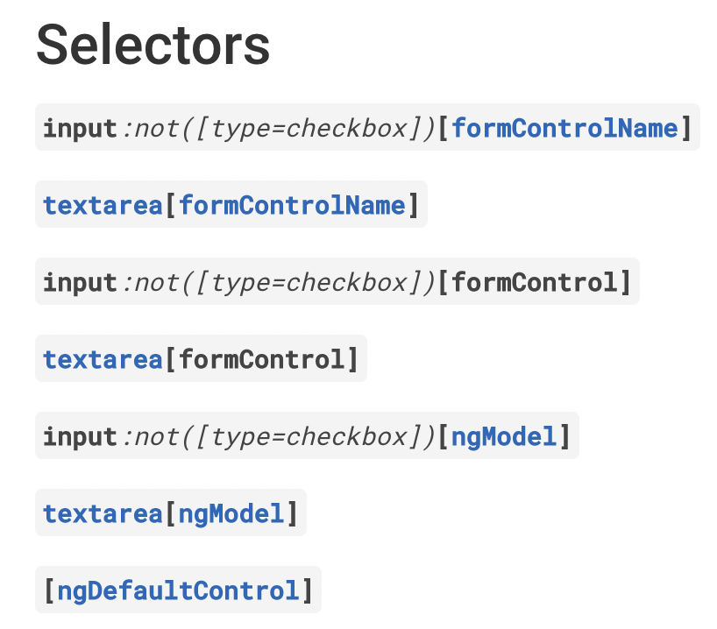
Origin element input…
DefaultValueAccessor

Slide 12
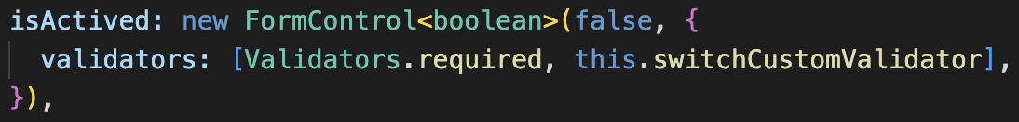
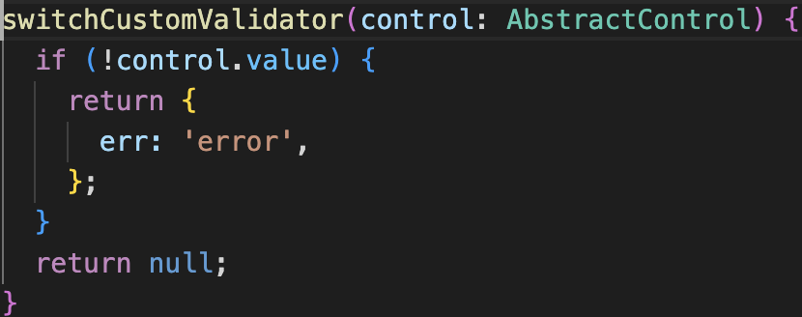
Validator
Validators
custom validator
customVal: (control)=> ValidationErrors|null
type ValidationErrors = { [key: string]: any; };

Slide 13
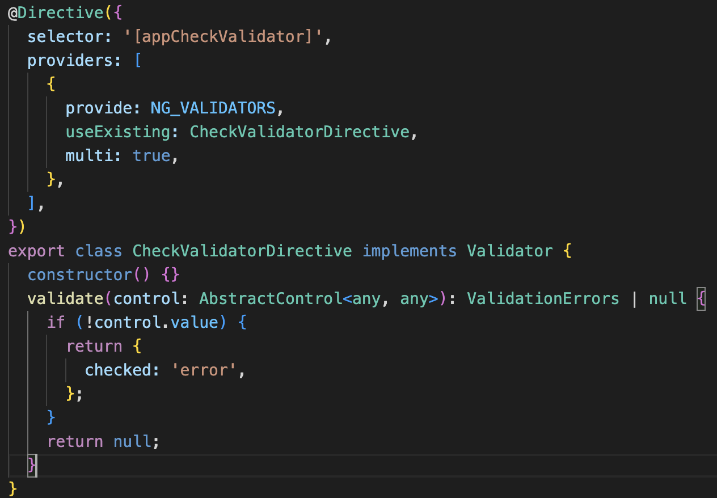
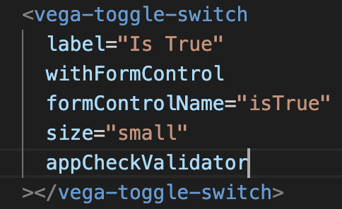
Validator directive
required, maxlength, minlength, email
custom validator directive

Slide 14
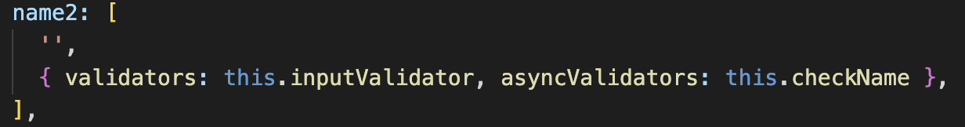
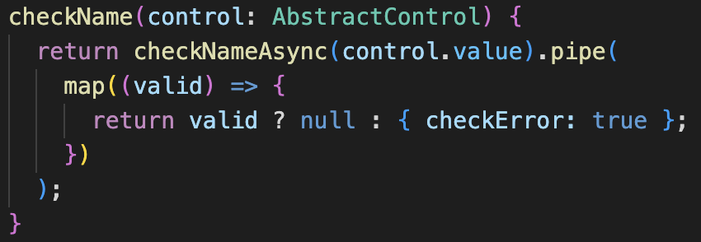
AsyncValidator
asyncValidators: customAsyncVal
customAsyncVal: (control)=> Promise<ValidationErrors | null> | Observable< ValidationErrors | null >

Slide 15
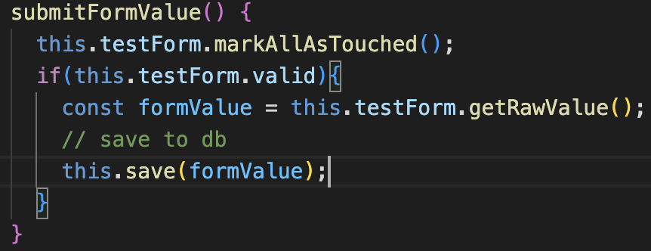
Sync validate before submit
sync validators

Slide 16
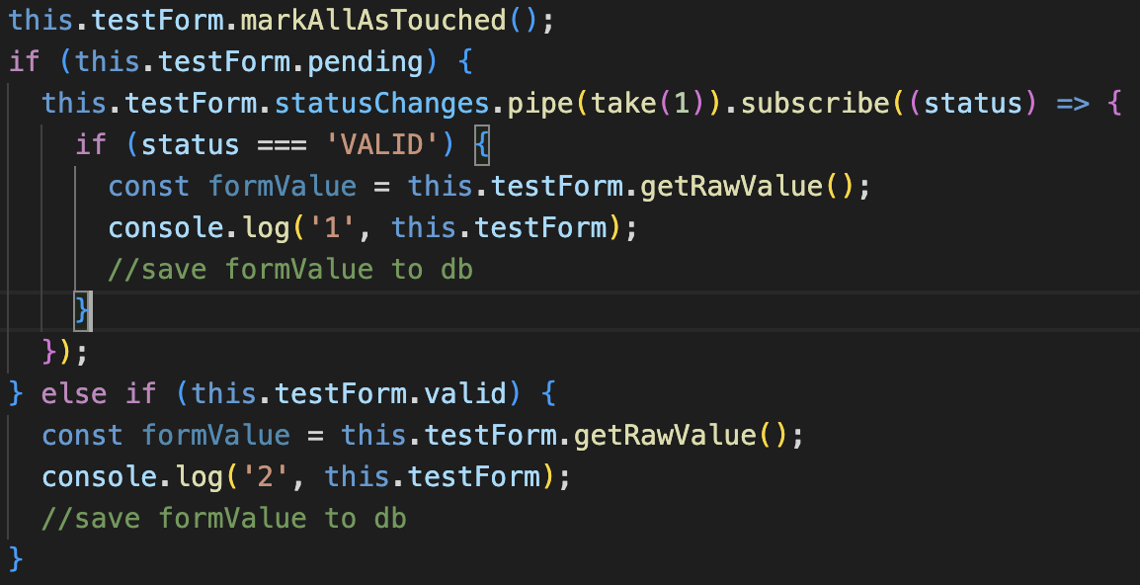
Async validate before submit
async validators

Slide 17


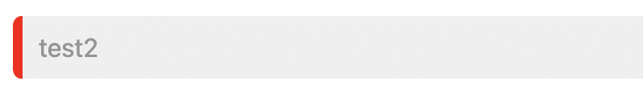
Class ng-*
ng-valid, ng-touched, ng-invalid, ng-untouched, ng-dirty, ng-pristine

Slide 18
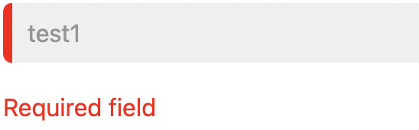
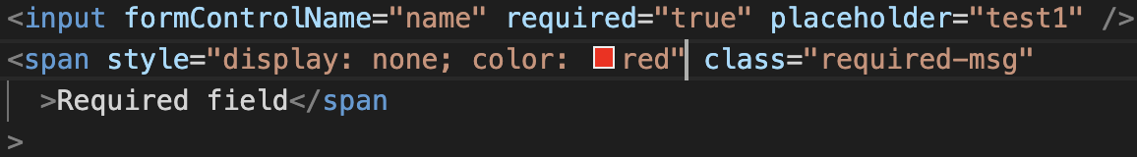

Error tip
style

Slide 19
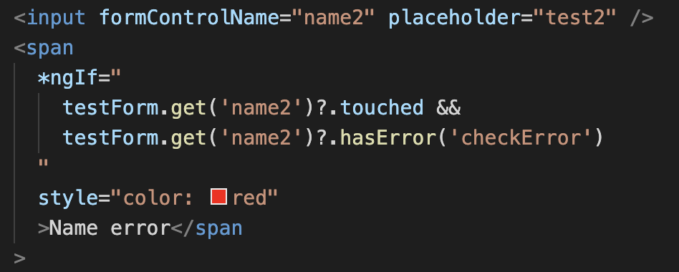
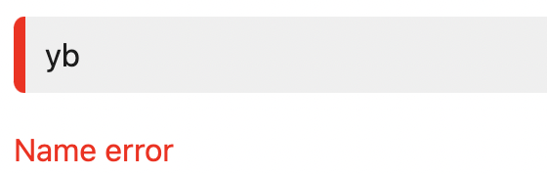
Error tip
template

Slide 20

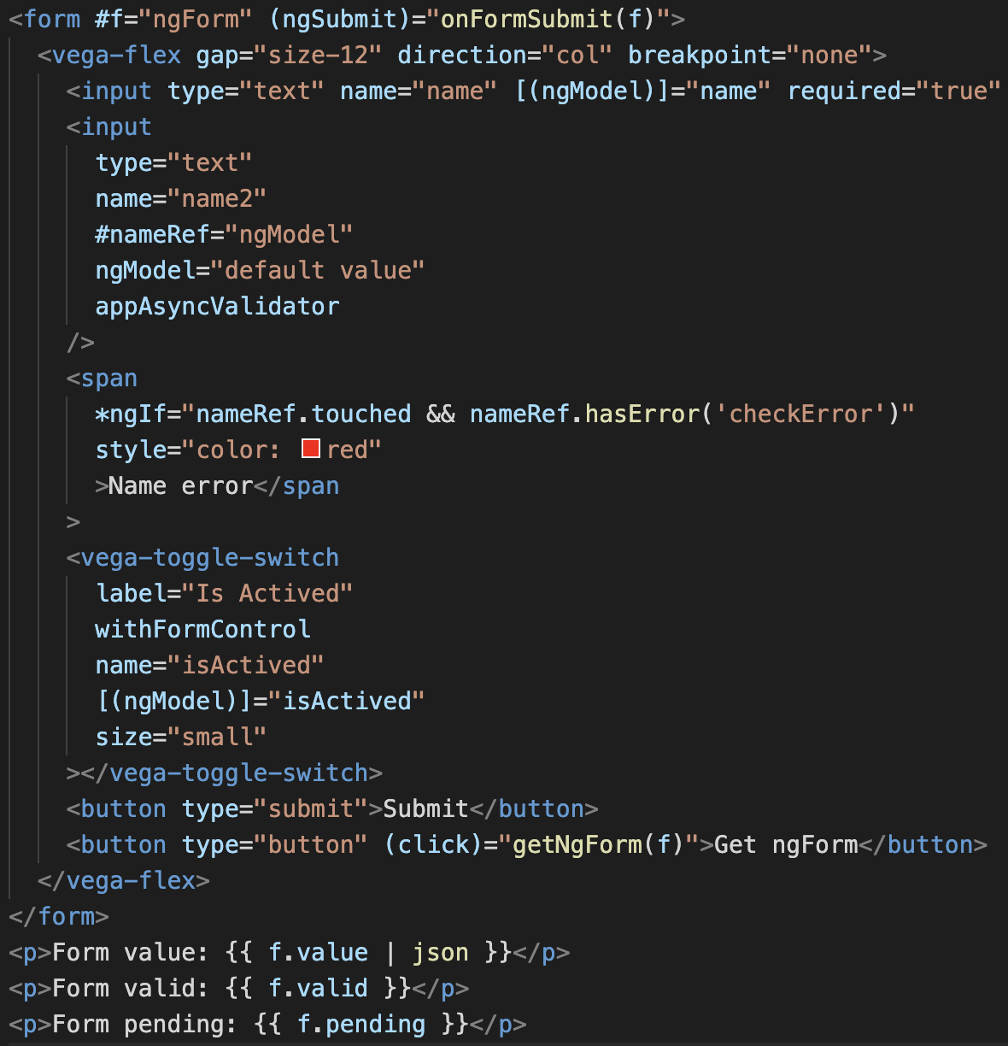
ngForm, ngModel
Template-driven form
FormsModule

Slide 21
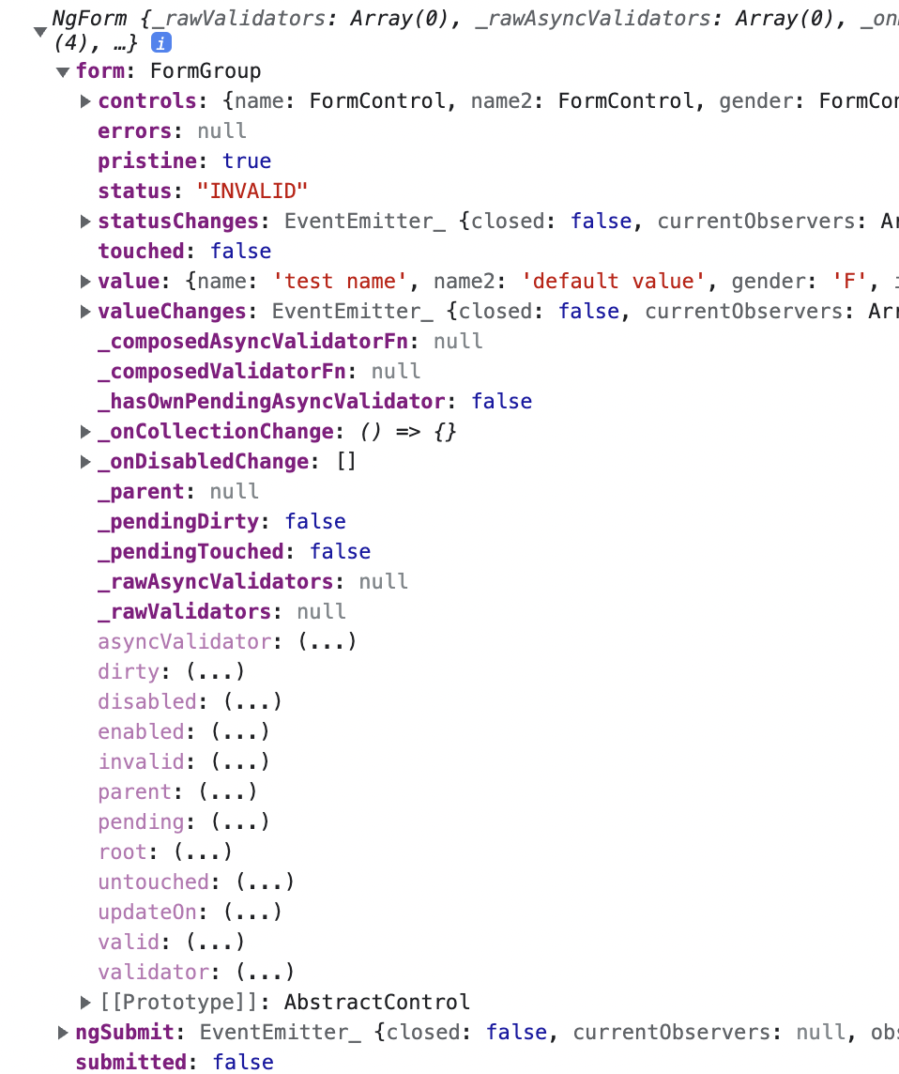
NgForm
submitted
value
status
controls
valid
form

Slide 22
Q&A
Thanks for watching

